Slide 1
Retail Customer Analytics
Christine Bwanakweri
3/11/2026

Slide 2


Business Problem
Understand customer purchasing behavior
Explore patterns in demographics and spending
Evaluate engagement with marketing campaigns
Identify insights that could help improve marketing strategies

Slide 3

Dataset Overview
Retail marketing dataset containing customer information
Includes demographics such as income, education, and marital status
Contains product spending data across multiple categories
Includes marketing campaign response information

Slide 4
Analysis Approach
Cleaned and prepared the data
Explored and queried the dataset
Performed exploratory data analysis
Created visualizations and a dashboard

Slide 5
Key Insight: customer Spending
Wine and meat products show the highest spending levels
Customers spend less on fruits, sweets, gold, and fish products
The company seems to rely a lot on a small group of customers who have high incomes and spend more money

Slide 6
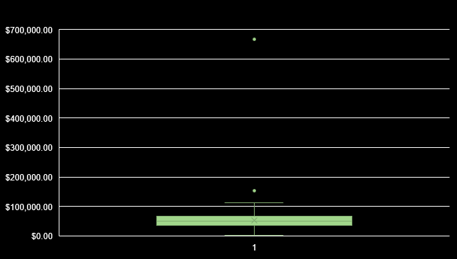
Key Insight: Income and Spending
Higher income customers tend to spend more on certain products
Wine spending shows a noticeable relationship with income
Some high-income outliers appear in the dataset
The middle 50% of customers earn roughly between $40,000 and $70,000, with a median income of around $51,000. Most customers fall within a typical income range of under $110,000. However, there are a few high-income outliers, including one extremely high value close to $670,000.

Slide 7
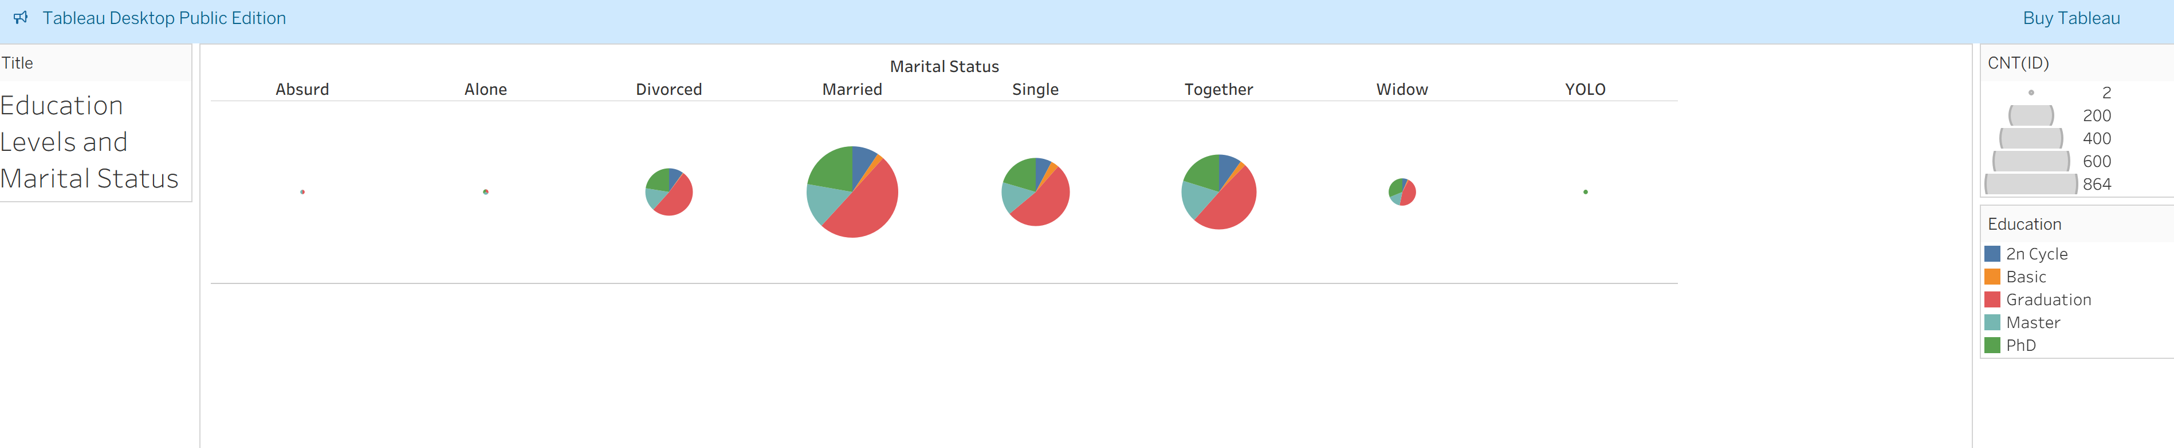
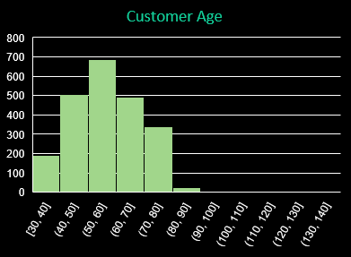
Key Insight: Customer Demographics
Graduation education group represents the largest segment
Many customers are married or in long-term relationships
Most customers fall between ages 40 and 70

Slide 8

Marketing Campaign Response
Most customers did not respond to marketing campaigns
Only a small portion accepted the offers
This suggest opportunities for improved campaign targeting
Response = 333 Customers
No Response=
1,883 Customers

Slide 9
Business Implications
High-income customers may be valuable marketing targets
Wine and meat products drive the most customer spending
Campaign response rates are low and may require better targeting
Customer demographics can help segment marketing strategies

Slide 10

Conclusion
EDA helped uncover patterns in customer demographics and spending
Visualizations made trends easier to identify
Insights from this analysis could help improve retail marketing strategies

